Slide 1
POLKADOT HACKATHON
ICE NETWORK – dApp NFT EVM in The SNOW NETWORK

Slide 2
BRAZIL TEAM (LOW TEAM)
About Team : Bruno Lowczy 27 Years Student Computer Engineering

Slide 3
About Project
This is a demonstration of a business project involving the creation of NFTs on the ethereum network, about a creator (Marketplace) of avatars (NFTS).
I didn't have the time or the staff to actually develop a real application. I also learned thanks to this event how blockchain technologies work. All work was carried out individually with the knowledge acquired over these 15 days
however I hope to be judged by the viability of the business

Slide 4
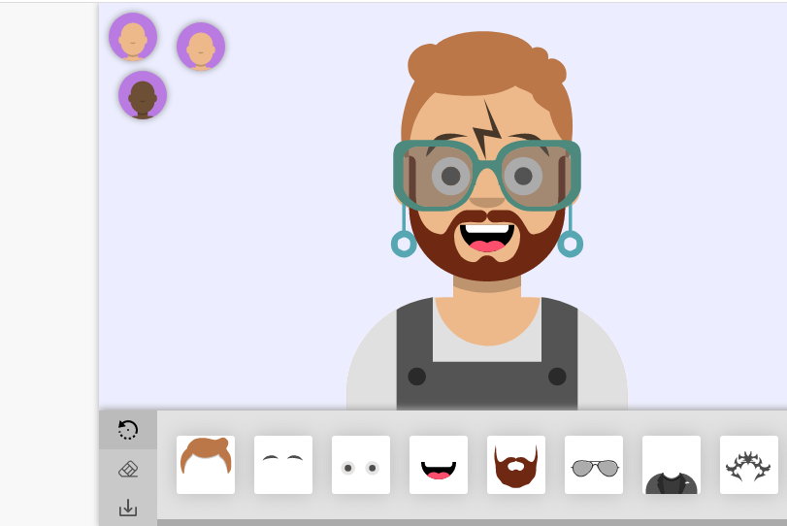
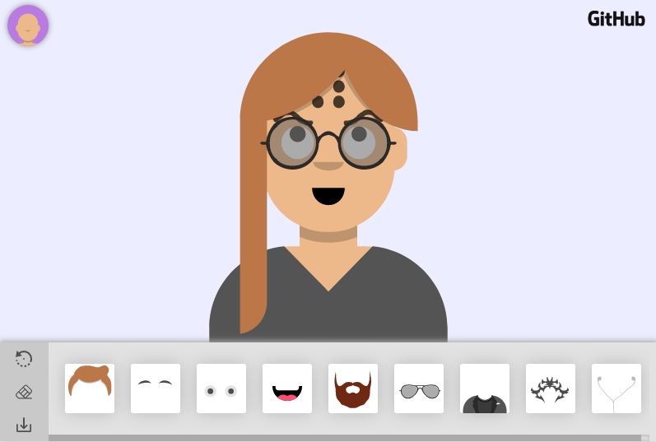
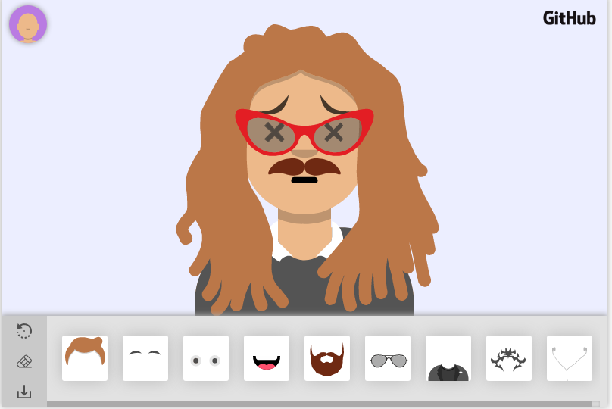
Creator Avatars
imagine you could create avatars in a web app/native android

Slide 5
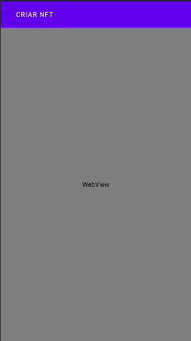
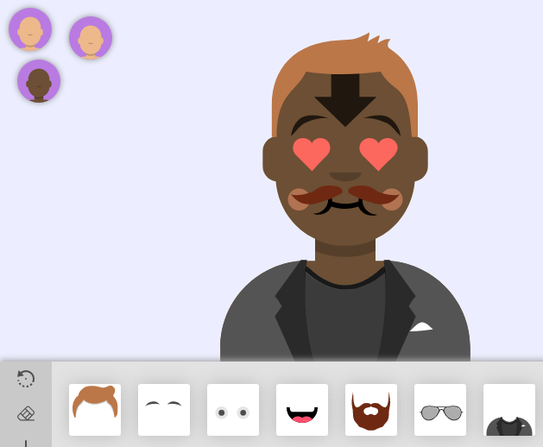
And Only one button create NFT’S
App Android model

Slide 6
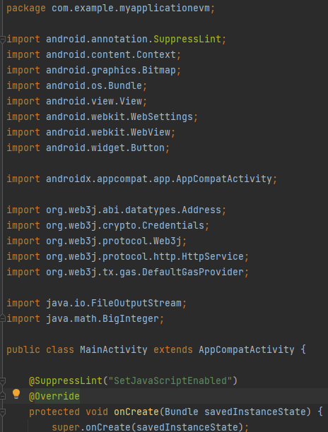
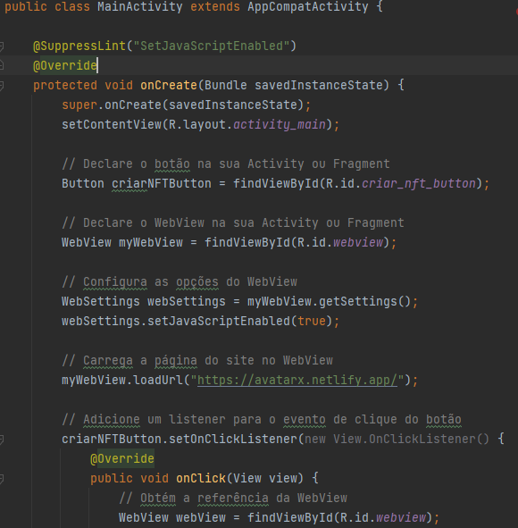
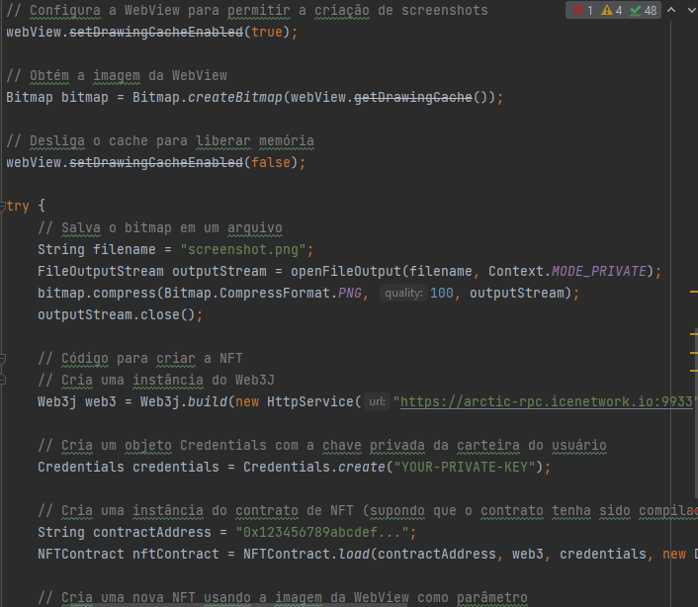
This is possible, look the code in app android

Slide 7
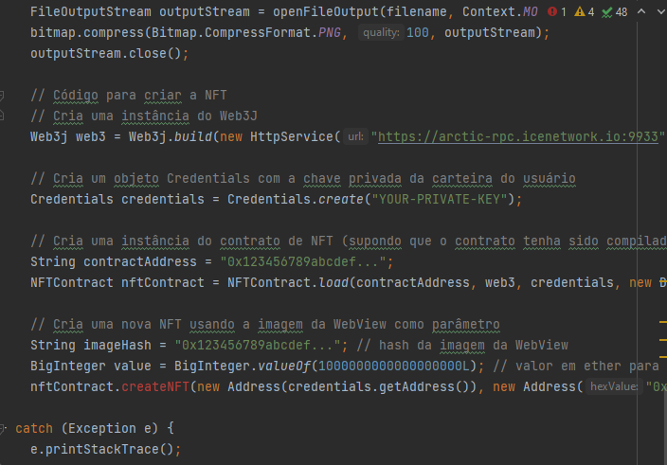
Pode ver o código inteiro em e todas as aplicações utilizadas em: www.github.com

Slide 8
Business Framework (SWOT)
FORTES (Strong) Inovation Business Valuing the ICE network Easy to use | FRACOS (Easy) It is not complete Need Very investments time and Money for new plattform
OPORTUNIDADES (opportunites) unveiling new artists great chances to move a lot of digital money great chance to attract young people and xyz generation , third age generation | DESAFIOS (Threats) Integrate this blockchain into other platforms Continue the development

Slide 9
Thank You
Conclusion
the project has the potential to become a large and first marketplace of avatars with the necessary investments all the SWOT analysis difficulties will be overcome

